Slide 1

Cyclistic Bike Sharing Analysis
By: Victor Oginni
Last Updated: 10 October 2022

Slide 2
Outline
Objective
Data Background
Methodology (Data Cleaning, manipulation and Analysis)
Insights
Recommendation

Slide 3
Objectives
To find how casual riders and annual members use cyclistic bike sharing differently and offer recommendation.

Slide 4
Data Background
The dataset was provide by Motivate International Inc.
12 dataset consisting of monthly bike sharing data was used for the analysis
The data period ranges from September 2021 - August 2022

Slide 5
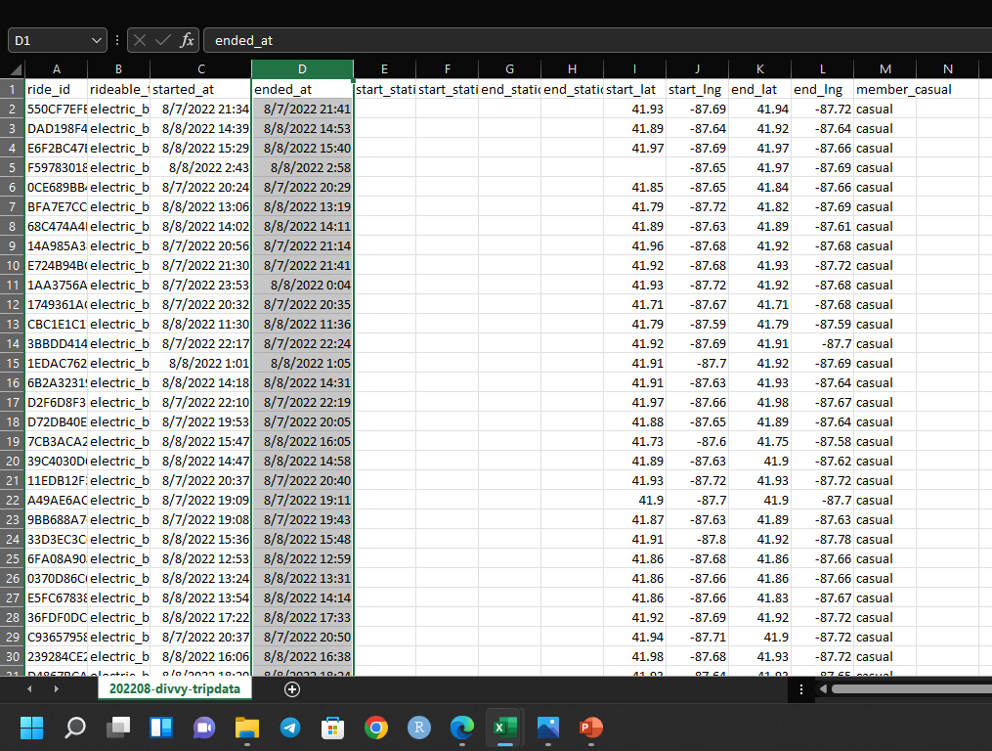
Methodology (Data Cleaning)
Microsoft Excel was used to perform data cleaning and manipulation.
The following data cleaning process were performed
The ride_id column was renamed as Trip_id
Member_casual column was renamed as Membership Type
The start_lat,start_lng,end_lat,end_lng columns were removed
The rideable_type column was renamed as Bike Type
The columns were checked for data consistency
These processes were carried on each of the datasets
Before cleaning

Slide 6
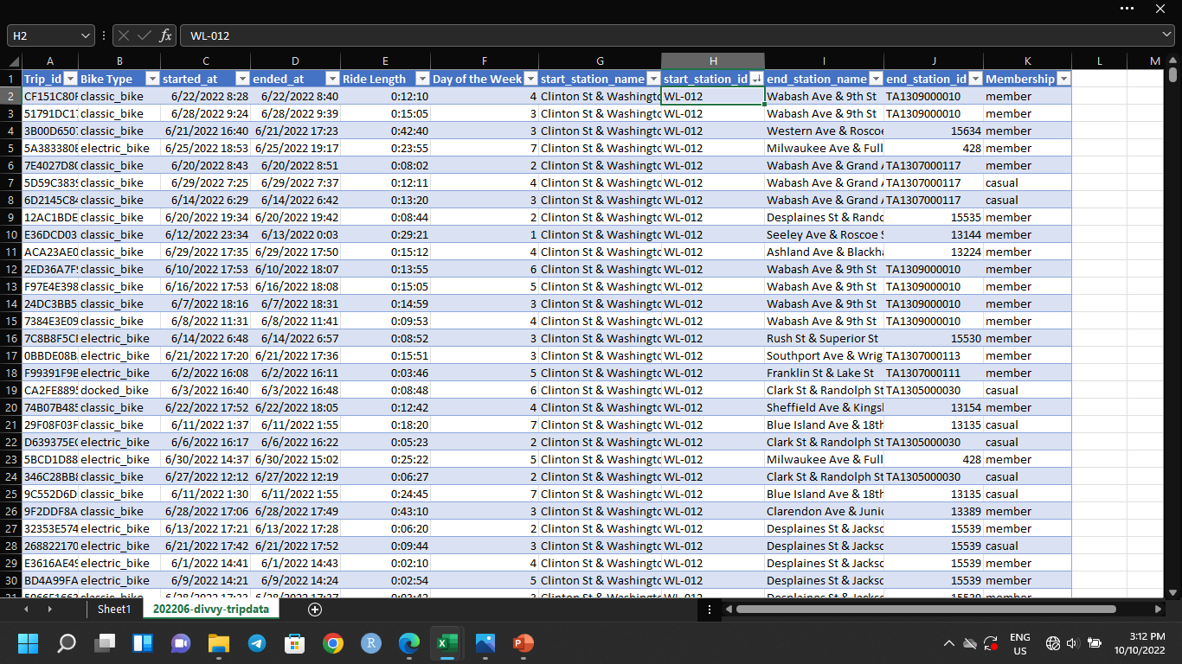
Methodology(Data manipulation)
A new column, Ride Length was created by finding the difference between the end time and the start time.
The ride length was formatted to hh:mm:ss (37:30:55)
Day of the week column was added using the formula =WEEKDAY(C2,1).
Some incorrect inputs were noted during the ride length calculations, the end time was before the start time, the affected rows were deleted.
These processes were carried on each of the datasets
After cleaning and manipulation

Slide 7
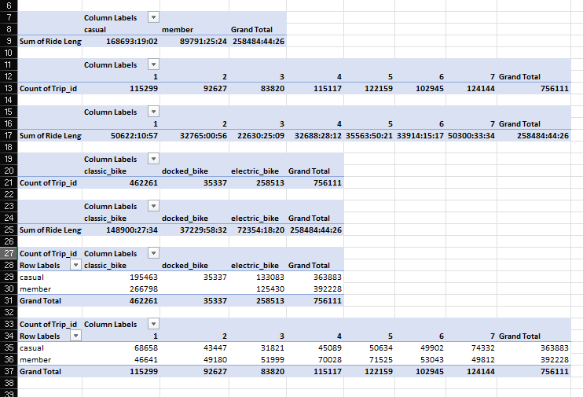
Methodology (Analysis)
The analysis were carried out using MS Excel
Each of the dataset were analyzed and a summary dataset was created.
The analysis carried out were to find
The number of rides on each day of the week by membership type
The ride length on each day of the week by membership type
The number of ride by membership type
Number of rides each day
Number of rides by bike type and users
Number of rides by membership type and total number of rides in the month
Analysis

Slide 8
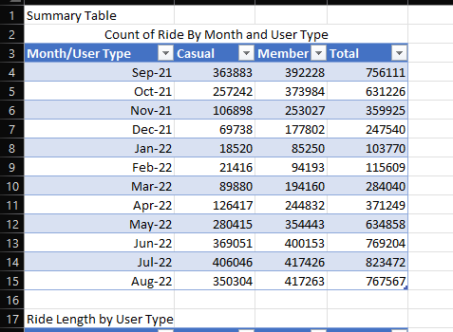
Methodology (Analysis)
The final analysis was done on the summary dataset
The following insights were generated:
Per Day Ride by Member Type
Ride per Month
Average ride length by member type
Average ride length by member type on different days of the week
Distribution of ride among member type
Bike type preference
Part of summary dataset

Slide 9
Insights
Ride per Month
The month of July has the highest number of ride with 823,472 rides.
There was an huge drop in numbers of rides from November to February
The drop in number of rides coincides with the winter period.
Rides are high in the summer and low in winter

Slide 10
Distribution of Rides
The members account for 58% of the total with that period
Casual riders account for 42% of total rides.
The monthly distribution of both member type are similar with both experiencing high number of rides in the summer and low number of rides in winter

Slide 11
Per day ride by Member type
The graph shows the number of rides taken by casual riders and annual members on each day of the weeks.
Weekends are the most popular days for casual riders. This could indicate that most casual riders ride for leisure.
Annual members take more rides on weekdays. This could indicate that annual members takes the bike to work.

Slide 12
Average Ride Length
The average ride length of Casual riders is 29 minutes 21 seconds
The average ride length of annual members is 12 minutes 51 seconds
Casual riders tend to drive for longer duration that annual members

Slide 13
Average Ride Length by days of the week
Casual Riders ride longer on weekend with an average ride length of 34 minutes 14 seconds and 32 minutes and 5 seconds on Sunday and Saturday respectively.
Annual members have a more uniform ride duration with a high 14 minutes 25 seconds on Sunday and a low of 12 minutes 11 seconds on Tuesday

Slide 14
Bike Preference
Electric bikes are the most preferred bike type among casual riders, docked bikes are the least preferred.
Classic bikes are the most preferred bike type among annual members.
It is interesting to note that no ride was made with a docked bike among annual members

Slide 15
Recommendation
More bikes should be made available during the summer to meet high demands during summer.
Annual members should be encouraged to take more trips outside work hours.
Discount should be offered to casual riders when they ride on weekdays to encourage them to make more rides on weekdays.
Incentives should be offered based on number of rides made.

